Slide 1

Building Cross Platform Libraries with Xamarin
Allan Ritchie – ACR SOFtware

Slide 2

Allan Ritchie
Former Microsoft & Xamarin MVP
Written a ton of Xamarin open source
Long time .NET developer
Lots of Azure – Had to say it, but saved it for last
blog: allancritchie.net
twitter: allanritchie911
twitch: allancritchie
github: aritchie

Slide 3
Agenda
How to get started
The Platforms & What to watch out for
CODE!
Multi-library vs Multitarget
Q & A

Slide 4
How to Get Started?
Pick Your Platforms
Start with a single C# interface
Start with iOS API’s, finish with Android API’s
Once you have a “lay of the land” – be prepared to even the playing field so you can make all platforms all work the same.
Decide on your structure – multi-library vs multi-target

Slide 5
How to Structure
Multi-Library
Compiles everywhere
Additional tooling such as NuGet packaging & SourceLink is a bit annoying to setup
A bit of witchcraft involved
Multi-Target
Only compiles properly in VS4win unless you use CLI on mac
NuGet & SourceLink setup is a cakewalk
Less witchcraft involved

Slide 6

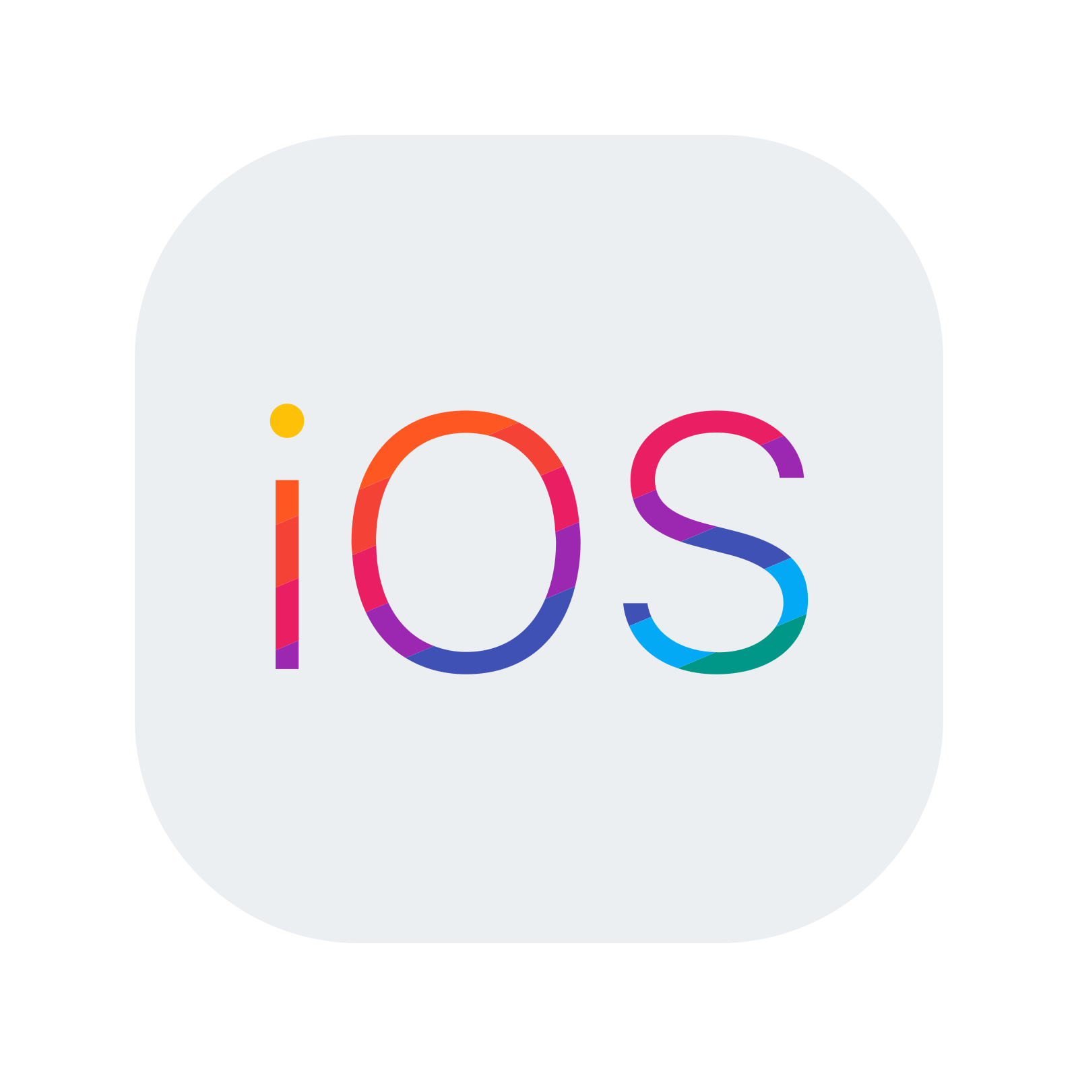





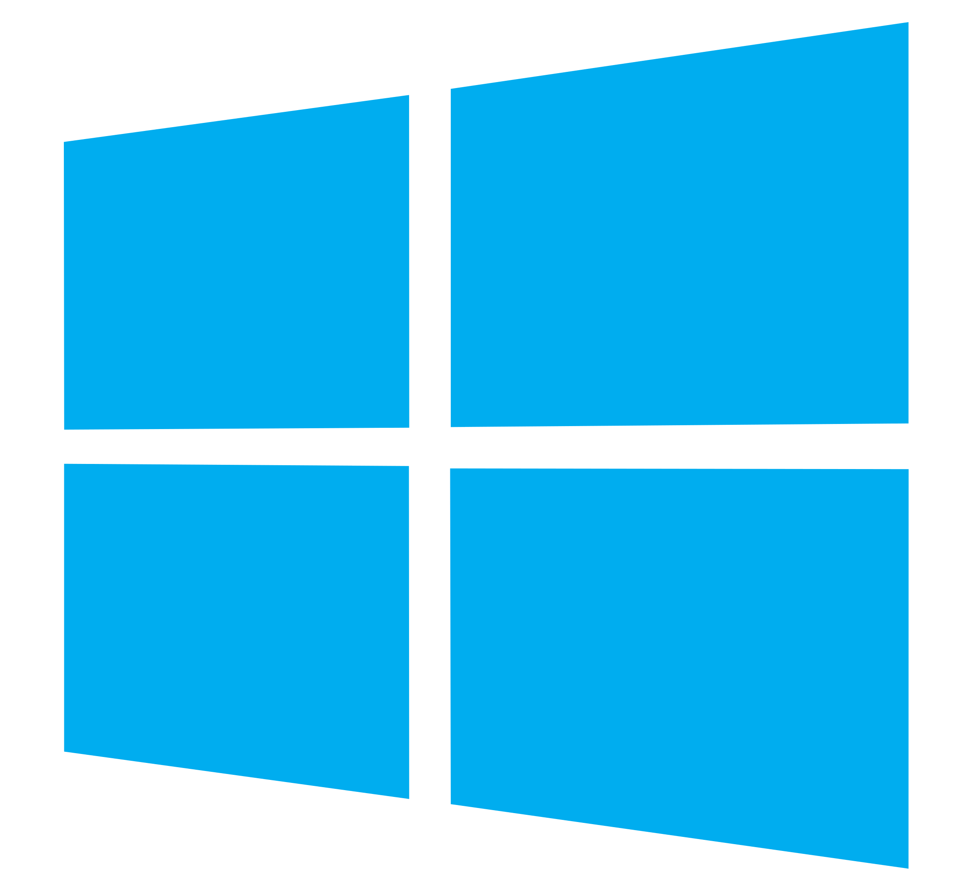
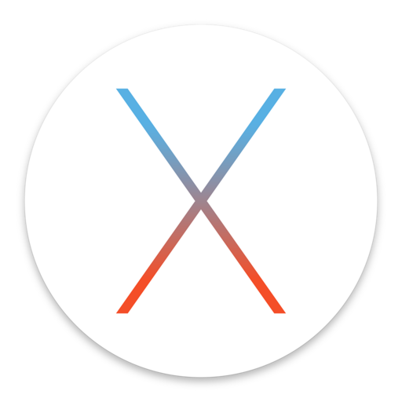
The Platforms!

Slide 7
Preparing for iOS
The Good
The API will handle everything
It will work without issue
Docs & StackOverflow answers are great
The Bad
Likely has the smallest API surface
If you intend to run things in the background, it will throttle your app or worse – shut it down, don’t go crazy
If the API starts with UI (even though it isn’t a UI thing), you need to make calls on the UI thread
Leveling the Playing Field
You may need to have feature flags to “tone down” functionality

Slide 8
Android
The Good
Will likely have the biggest API surface
The official docs are good
The Bad
You will probably need an external dependency on the support libraries
Google deprecates API’s A LOT!
Contexts….contexts everywhere!
There will be bugs
The API won’t remember a thing for you. It won’t survive reboots either!
Leveling the Playing Field
Have a persistence layer to remember your requests so you can restore them when your app starts or the device reboots

Slide 9
Universal Windows Platform (UWP)
The Good
The API surface will often match Android
Setting up the backgrounding is easy
Debugging is fast & just works
The Bad
When you have a problem, StackOverflow may not save you
COM errors…. (*&#(%*&(&#$%
EVERYTHING is async - even when it doesn’t need to be
Leveling the Playing Field
Just like Android – be prepared to kick UWP back into shape

Slide 10
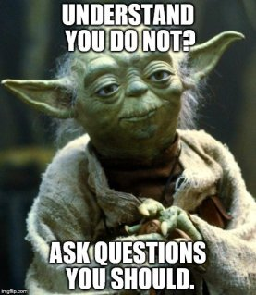
Q&A + Resources
https://allancritchie.net
https://github.com/shinyorg
https://github.com/Xamarin/essentials
https://github.com/jamesmontemagno/PermissionsPlugin

